Slide 1
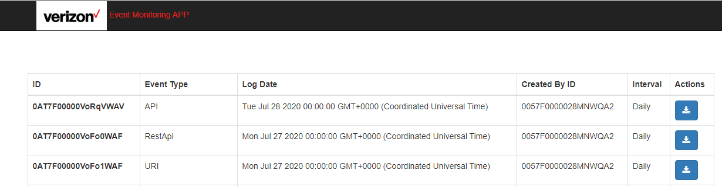

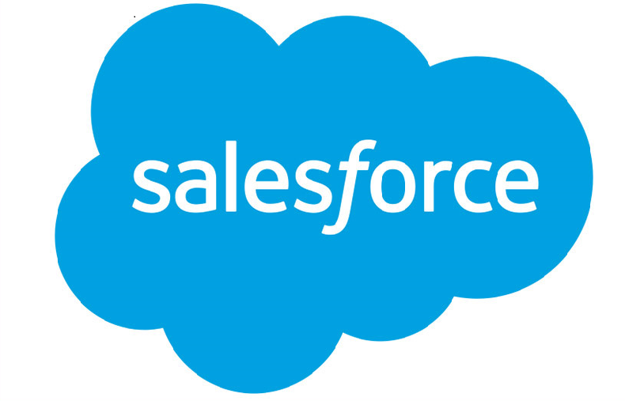
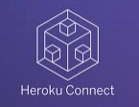
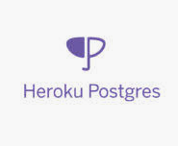
App Flow Diagram

Slide 2
Pre-requisites
Followings are the pre-requisites:
Install Node.js
Install Express
Heroku Account
Heroku connect
Heroku PostGres
This will not consume Salesforce API limit. Salesforce Log available permanently in Heroku Postgres.

Slide 3
License Available in Market
Below are some great ISVs (independent software vendors) who already build on top of Event Monitoring:
Salesforce Analytics Cloud and the Wave Platform
Splunk
New Relic
Fairwarning
ezCloudAudit
SkyHigh Networks
Cloudlock

Slide 4
With Other Tools
Followings are the Salesforce Limitations:
This will consume Salesforce API limit. (using Bulk API, Striming API etc.)
Enterprise, Unlimited, Performance Edition: Login/Logout log lines for free with 1 day data retention
Enterprise, Unlimited, Performance Edition: full 28 log lines for add-on price with 30 day data retention
Developer Edition: full 28 log lines for free with 1 day data retention
The number of delivered events to external CometD clients is counted per subscribed client. If you have multiple client subscribers, your usage is added across all subscribers. For example, you have an Unlimited Edition org with a default allocation of 50,000 events in a 24-hour period. Within a few hours, 20,000 event messages are delivered to two subscribed clients. You have consumed 40,000 events, and you are still entitled to 10,000 events within the 24-hour period.
https://developer.salesforce.com/docs/atlas.en-us.platform_events.meta/platform_events/platform_event_limits.htm
https://help.salesforce.com/articleView?id=000326126&language=en_US&type=1&mode=1
https://developer.salesforce.com/docs/atlas.en-us.216.0.salesforce_app_limits_cheatsheet.meta/salesforce_app_limits_cheatsheet/salesforce_app_limits_platform_api.htm

